Slide 1
Working Agreement
Paskaitas pradedame 13:45 ir skiriame 15 min. bendriems reikalams ir pokalbiams apie bet ką
Paskaitas baigiame ne vėliau nei 18 val.
Darome 10-20 min. pertraukas kas 1 val.
Visada įsijungiame video kameras, jei leidžia galimybės
Išjungiame mikrofonus tuo metu kai nekalbame
Drąsiai klausiame - jei kas nors neaišku arba pakeliame ranką. Prašome pagalbos jei stringame
Gerbiame vieni kitus ir vieni kitų laiką bei skirtingas nuomones

Slide 2
Java Stream: Basics
Swedbank IT Academy 2021
Deividas Kybartas
Notes:
Prisistatymas. Esu Deividas Kybartas. Swedbanke esu 3 metai ir 2 dienos. Aš taip pat atėjau į swedbanką iš IT Akademijos. Baigiau KTU PS ir prieš pusmetį baigiau PSI magistrą KTU. Swedbanke aš pagrinde užsiemu backu su java, prieš ateinant į swedbanka dirbau su mobiliujų programėlių kūrimu android ir ios native šiek tiek prisilėsdamas ir prie backo, o atėjas į swedbanką pilnai pasinėriau į UML ir backandą

Slide 3

Java environment types Basic syntax Variables, methods and variable modifiers Data types Java keywords Java operators Control statements Java loops, Arrays
Today’s agenda:

Slide 4
Goals for today
Learn Java language basics
Learn Java coding conventions
Get familiar with IntelliJ IDEA

Slide 5
Basic syntax
Case Sensitivity − Java is case sensitive, which means identifier Hello and hello would have different meaning in Java.
Class Names − For all class names the first letter should be in Upper Case. If several words are used to form a name of the class, each inner word's first letter should be in Upper Case. Example: class MyFirstJavaClass
Method Names − All method names should start with a Lower Case letter. If several words are used to form the name of the method, then each inner word's first letter should be in Upper Case. Example: public void myMethodName()
Program File Name − Name of the program file should exactly match the class name. When saving the file, you should save it using the class name (Remember Java is case sensitive) and append '.java' to the end of the name (if the file name and the class name do not match, your program will not compile). Example: Assume 'MyFirstJavaProgram' is the class name. Then the file should be saved as 'MyFirstJavaProgram.java'
public static void main(String args[]) − Java program processing starts from the main() method which is a mandatory part of every Java program.
Package – All packages must be lowercase and separated by dot. Example: com.swedbank.itacademy.java.basics
Notes:
Tai basic sintaksė kaip mes apsirašom, klases, metodus, kintamuosius. Tai pirma dalykas yra, kad jeigu kintamajį ar metodą pavadinsit iš mažosios raidės, o paskui tą patį žodį parašysit iš didžiosios tai bus du skirtingi dalykai, ir tai nebus vienas ir tas pats.
Klasių vardus javoje rašome iš didžiosios raidės, ir kiekvienas sekantis žodis taip pat pradedamas iš didžiosios raidės. Jei rašysit iš mažosios techniškai veiks, bet tai tiesiog javos ekosistemos susitarimas, kad rašome iš didžiosios. Tokios pat taisyklės yra aprašytos ir kodo prižiūrimumo įrankiuose, jeigu nesilaikot tokių taisyklių tai akivaizdu, kad geriausių rodiklių įrankiai neparodys
metodų vardams yra naudojamas camelCase tai reiškia, kad kiekvienas pirmas žodis prasideda mažaja raide ir kiekvienas kitas žodis prasideda iš didžiosios raides. čia vėl yra bendras javos pasaulio susitarimas
Programų failų vardai būtinai turi sutapti su javos klasės vardu, jei šio varianto nesilaikysit tai techniškai neveiks programa, tiesiog nesikompiliuos
tai yra pagrindinis metodas, nuo kurio prasideda javos veikimo programa

Slide 6
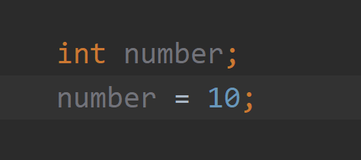
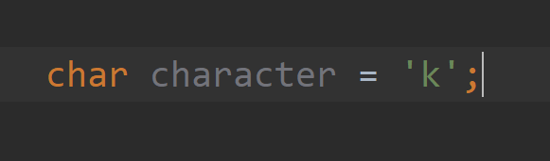
Variables
Variables are containers for storing data values. In Java, there are different types of variables, for example:
String - stores text, such as "Hello". String values are surrounded by double quotes
int - stores integers (whole numbers), without decimals, such as 123 or -123
float- stores floating point numbers, with decimals, such as 19.99 or -19.99
char - stores single characters, such as 'a' or 'B'. Char values are surrounded by single quotes
boolean - stores values with two states: true or false
Variable has to be declared if you want to use it for example:
Notes:
Javoje variablai yra skirti storinti(laikyti) informaciją. Pavyzdiui jeigu norime saugoti tam tikrą textą tai naudosime String kintamaji, jeigu norime saugoti sveika skaiciu tam yra skirtas int(integer), skaiciams po kalbelio naudojam float arba double kintamuosius, char gali saugoti tik viena simboli, o boolean kintamasis turi tik dvi reiksmias ture arba false
kintamijei javoje yra aprasomi nurodant kintamojo tipa varda ir nurodant reiksme
-2147483648 to 2147483647
-9223372036854775808 to 9223372036854775807
metodai pakalbeti, kintamieji i viena eilute

Slide 7
Data types
Data types are divided into two groups:
Primitive data types - includes byte, short, int, long, float, double, boolean and char
Non-primitive data types - such as String, Arrays and Classes
Primitive type | Wrapper Class
boolean | Boolean
byte | Byte
char | Character
float | Float
int | Integer
long | Long
short | Short
double | Double

Slide 8
Variables (methods and classes)
Local variables - are declared in methods, constructors, or blocks. Local variables are created when the method, constructor or block is entered and the variable will be destroyed once it exits the method, constructor, or block.
Instance variables - declared in a class, but outside a method. When space is allocated for an object in the heap, a slot for each instance variable value is created. Instance variables hold values that must be referenced by more than one method, constructor or block, or essential parts of an object's state that must be present throughout the class.
Class variables - also known as static variables are declared with the static keyword in a class, but outside a method, constructor or a block. There would only be one copy of each class variable per class, regardless of how many objects are created from it.

Slide 9
Variable modifiers
static – a variable type often used when we want to save space because only one single copy of static variable is created and shared among all of the instances of the class. Static variables don’t require a class to be initialized to access them.
final – a variable type often used to declare constants with the static keyword. This means that when a value is assigned it can not be changed.
public – a variable type used when we want to allow any other object to access a variable.
private - a variable type used when we want to restrict access to variables declared in a class. Private variables are only visible to the class to which they belong

Slide 10
Java keywords
Java keywords are also known as reserved words. There are 51 of them. Keywords are particular words which acts as a key to a code. These are predefined words by Java so it cannot be used as a variable or object name. Some more common keywords are:
throws | class | extends | if | null
case | else | final | import | package
catch | default | finally | implements | public
break | enum | for | new | return
static | switch | this | while | try

Slide 11
Java operators
There are four groups of operators:
Arithmetic Operators – are used in mathematical expressions to do various calculations.
Comparison Operators – are used to compare two or more values.
Logical Operators – are used to determine the logic between variables or values
Assignment Operators – are used to assign values to variables.

Slide 12
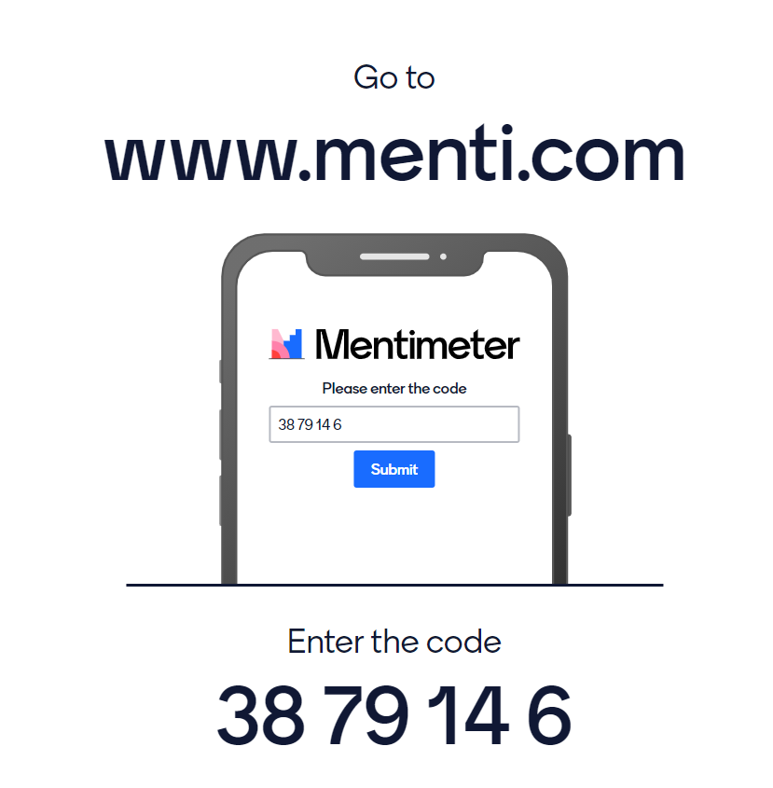
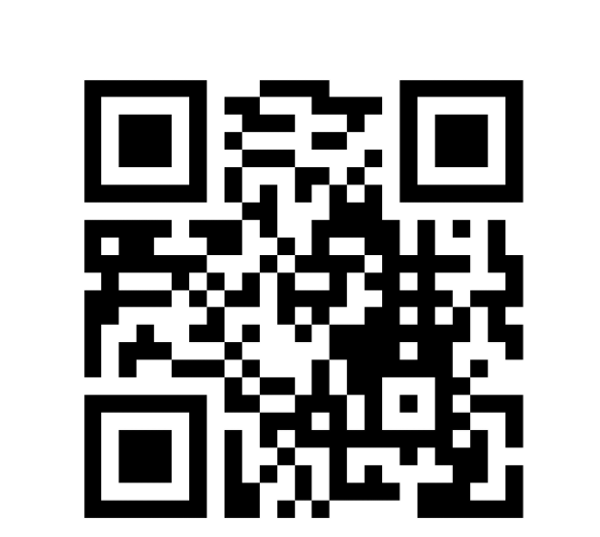
MENTI

Slide 13
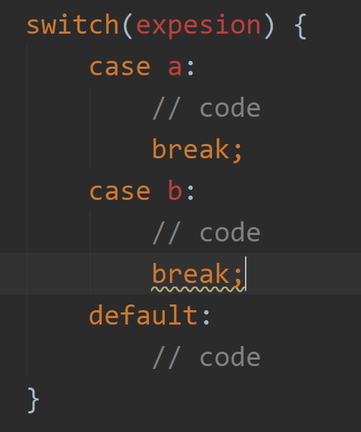
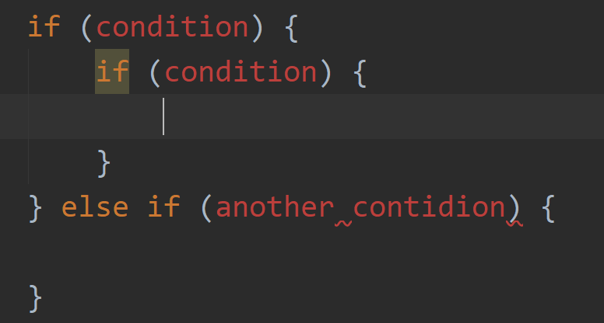
Control statements
Control statements are used to do decisions and execute different code based on some sort of logic.
if, if-else, nested if – these control statements use logical operators to evaluate values and execute code blocks based on the evaluation result.
switch – this control statement is used when there is a predefined set of cases that you will have in your code and you want to execute a different code blocks based on the case. Switch evaluates expression only once.

Slide 14
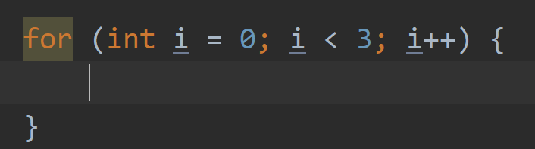
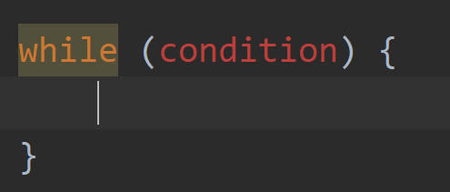
Java loops
Loops in Java are used when you need to execute same code block for a certain amount of times of until a condition is satisfied.
for loop – this loop is used when you know how many times you need to run your code block.
while loop – this loop is used when you want to run your code block until your condition is satisfied.

Slide 15
Tasks

Slide 16
Task 1
Prerequisites:
Create package named lt.itacademy.java.basics
Create class named Basics with main method to execute your program.
Task:
From console input read three variables your name, surname and age. Concatenate them together with “Hello I am” and “I am attending IT Academy 2021!”
Input: Name Surname age
Output: Hello I am Name Surname. I am attending IT Academy 2021!

Slide 17
Task 2
Prerequisites:
Continue in the same Basics class.
Task:
Create all of the primitives (except long and double) with different values. Concatenate them into a string and print it to the screen.
Output: H3110 w0r1d 2.0 true

Slide 18
Task 3
Prerequisites:
Continue in the same Basics class.
Task:
Write a Java method that accepts two integers and then prints the sum, the difference, the product, the multiple, the distance (the difference between integer), the maximum (the larger of the two integers), the minimum (smaller of the two integers).
Hint: (optional) The Java Math class

Slide 19
Task 4
Prerequisites:
Create class named Arithmetics in the same package as before with main method to execute your program.
Task:
Calculate cube’s volume and perimeter.
Input: 5
Output:
Cube’s volume: 125cm3.
Cube’s perimeter: 30cm.

Slide 20
Task 5
Prerequisites:
Continue in the same Arithmetics class.
Task:
Create a method which converts feet and inches to centimeters. It needs to have two parameters. First parameter is feet and second is inches.
Hint: 1 inch = 2.54cm and 1 foot = 12 inches
Input: 2.4 4
Output: 2.4 feet and 4.0 inches = 5,083,312000 cm

Slide 21
Task 6
Prerequisites:
Create class named Operators in the same package as before with main method to execute your program.
Task:
Create a method which determines whether triangle is Equilateral (has three equal sides), Isosceles (has two equal sides), Scalene (has no equal sides). Program takes 3 input values (triangle sides).
Input: 8 8 8
Output: Triangle is Equilateral. Sides: 8 8 8

Slide 22
Task 7
Prerequisites:
Continue in the same Operators class.
Task:
Create a method which determines whether a car will be able to drive to the destination or not. In case if car is not able to drive. Print out how much fuel does it need to fill the tank more to be able to drive to the destination as well as how much will it cost. If it is able to drive to the destination write how much fuel will it have left on the tank. Program has four parameters: distance to the destination, how much fuel does the car have in the tank, car fuel usage per 100km and fuel price per liter.
Input (negative flow): 100 6 7 1.25
Output: Destination is in 100km. Car is not able to reach the destination. It needs 1 liter of fuel more. It will cost 1.25.
Input (happy flow): 110 25 7 1.25
Output: Destination is in 110km. Car is able to reach the destination. It will have 17.3 liters of fuel left.

Slide 23
Task 8
Prerequisites:
Create class named Loops in the same package as before with main method to execute your program.
Task:
Create a method which calculates how many hours and minutes are in one year (365 days). You must use for loop to get the answer. You can’t just multiply days and hours. Only one input is required days per year.
Input: 365
Output: There are 8760 hours or 525600 minutes in one year.

Slide 24
Task 9
Prerequisites:
Continue in the same Loops class.
Task:
Refactor you for loop into while loop. You should get the same output as in Task 7.
Input: 365
Output: There are 8760 hours or 525600 minutes in one year.

Slide 25
Task 10
Prerequisites:
Continue in the same Loops class.
Task:
Choose while or for loop and calculate factional of a number. Your program should take an integer number and calculate it’s factorial and output response to the console.
Input: 5
Output: Factorial of number 5 is 120.

Slide 26
Task 11
Prerequisites:
Create class named Calculator in the same package as before with main method to execute your program.
Task:
Using what you have learned create a calculator which will calculate figures perimeter and area. You must use switch statement for choosing a figure. Program should run as long as you want to continue using calculator. This means that after calculations are done it must ask if you want to run it again. You must check whether input values are correct if not write an error message that values were incorrect. Calculator must be able to calculate Triangle, Rectangle and Square perimeter and area.
Input (happy flow): Rectangle 5 7
Output: Rectangle perimeter is 24 and area is 35.
Input (negative flow): Rectangle 0 7
Output: Rectangle line value can’t be 0.

Slide 27
Optional task 1
Task:
- write a Java method to check whether a string is a valid password.
Password rules: - A password must have at least ten characters. - A password consists of only letters and digits. - A password must contain at least two digits.
Input : qwerty123456
Output: Password is valid: qwerty123456

Slide 28
2x Optional task 2
Task:
- There is a string s of lowercase English letters that is repeated infinitely many times. Given an integer n find and print the number of letter a in the first n letters of the infinite string
Example:
Input: n = 10; s = abcac
Output: 4
Why?: The substring we consider is abcacabcac the first 10 characters of the infinite string. There are 4 occurrences of a in the substring.
Another example: int: n = 10000000000; s = a; out: 10000000000

Slide 29
3x Optional task 3
Task:
Write a Java program to given two non-negative integers x and y represented as String, return the sum of x and y
Example:
Input: x = “200”; y = “201”;
Output: 401

